Slide 1
Borough Updates

Slide 2
Construction Ordinance Changes
Flood Mitigation Committee
Single Use Plastics
Capital Projects
Road Projects
Beach & Bay
2019 Budget Timeline
Q & A

Slide 3
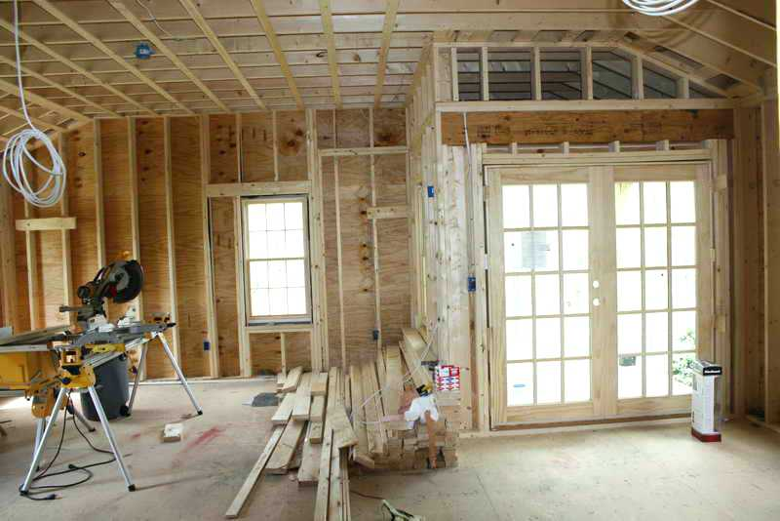
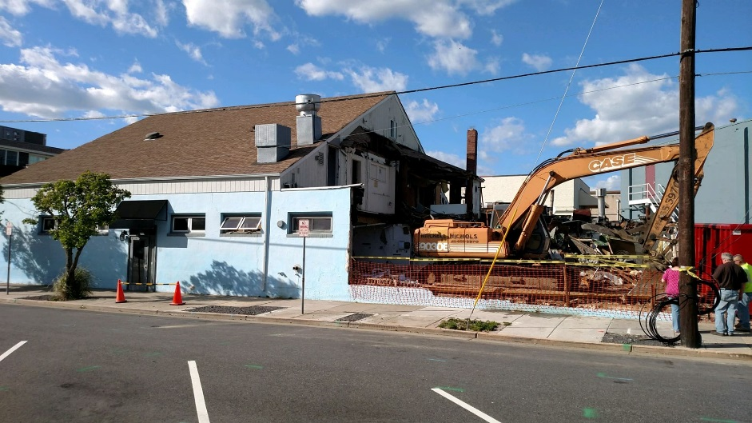

Slide 4
Flood Mitigation Committee
Mayor
Councilwoman Josee Rich
Councilman Ray Parzych
Borough Administrator Jill Gougher
Mott & Associates, Paul Kates, Planning Board Engineer
Remington & Vernick, Ryan McGowan, Engineer
DeBlasio & Associates, Marc DeBlasio, Borough Engineer
Wally Bishop, SHPOA
Dr. Lenore Tedesco, Wetlands Institute

Slide 5
SINGLE USE PLASTICS
Ordinance passed this summer – effective June 1, 2019
New Jersey will NOT be passing legislation – Governor veto
Meeting with Chamber of Commerce on September 27
Avalon is passing similar ordinance at their next meeting

Slide 6
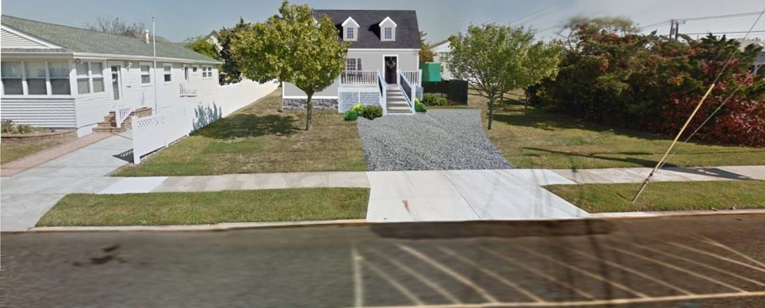
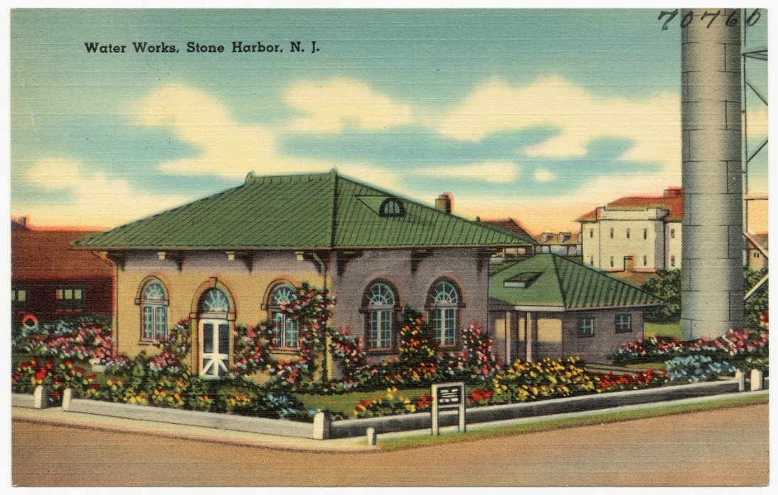
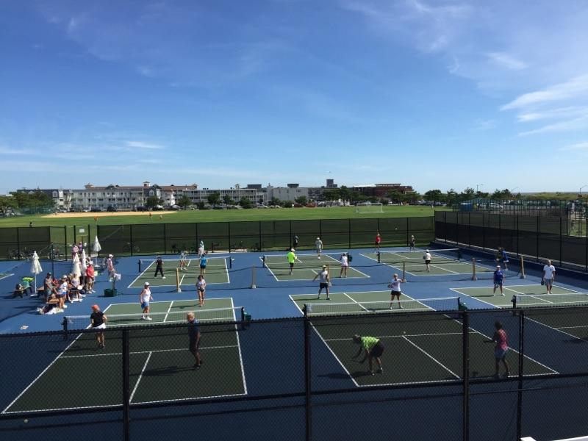
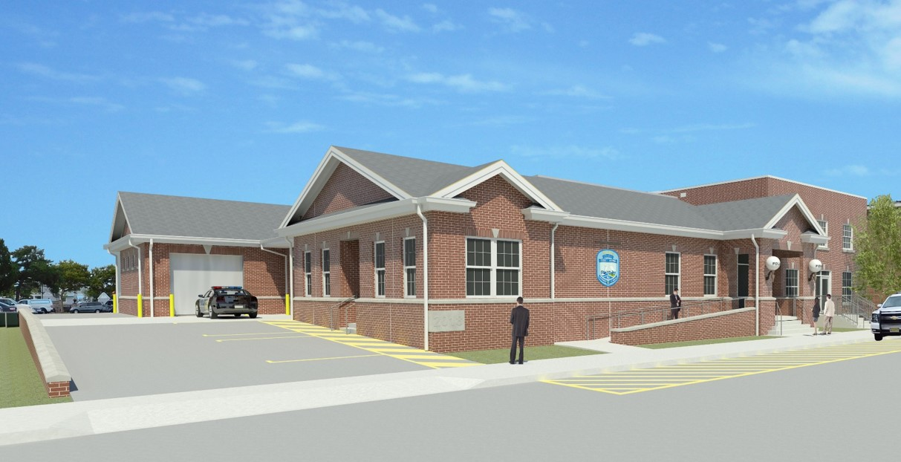
Capital Projects
Comfort Station
93rd Street Sanitary & Stormwater Pump Station
Tennis & Pickleball Support Building
Police Station

Slide 7
Road and Utility Projects
Roadway, Water & Sewer
92nd Street (Sunset to Third Avenue
100th Street (Beach to First Avenue)
101st Street (Beach to First Avenue)
102nd Street (Beach to First Avenue)
106th Street (Third Avenue to the Bay)
108th Street (Beach to First Avenue)
Chelsea Place (Second to Third Avenue)
110th Street (Beach to Second Avenue)
122nd Street (Beach to Second Avenue)
Third Avenue (96th to 99th Street)
118th Street (Second Avenue Intersection)
Paving Only
88th Street (Sunset to the Bay)
108th Street (Second to Third Avenue)
NOTE: Dependent upon funding – if not enough in 2018 paving only will be done in 2019

Slide 8
Road and Utility Projects continued…..
South Jersey Gas will be doing final paving of impacted streets this fall. Roads will be restored to original condition, including striping, bike lanes and patches.

Slide 9
2019 Budget Review Time Line
September 14, 2018: Budget documents sent to all department heads to prepare documents for Council Committee review
October/November: Budgets requests reviewed by Council Committees
November 21, 2018: Budgets are returned to CFO and Administrator
December 4 & 18, 2018: Council Work Sessions: Department budgets are presented to Mayor and Council for review
February 19, 2019: 2019 Budget introduced at Council Meeting
March 19, 2018: 2019 Budget adopted at Council Meeting

Slide 10
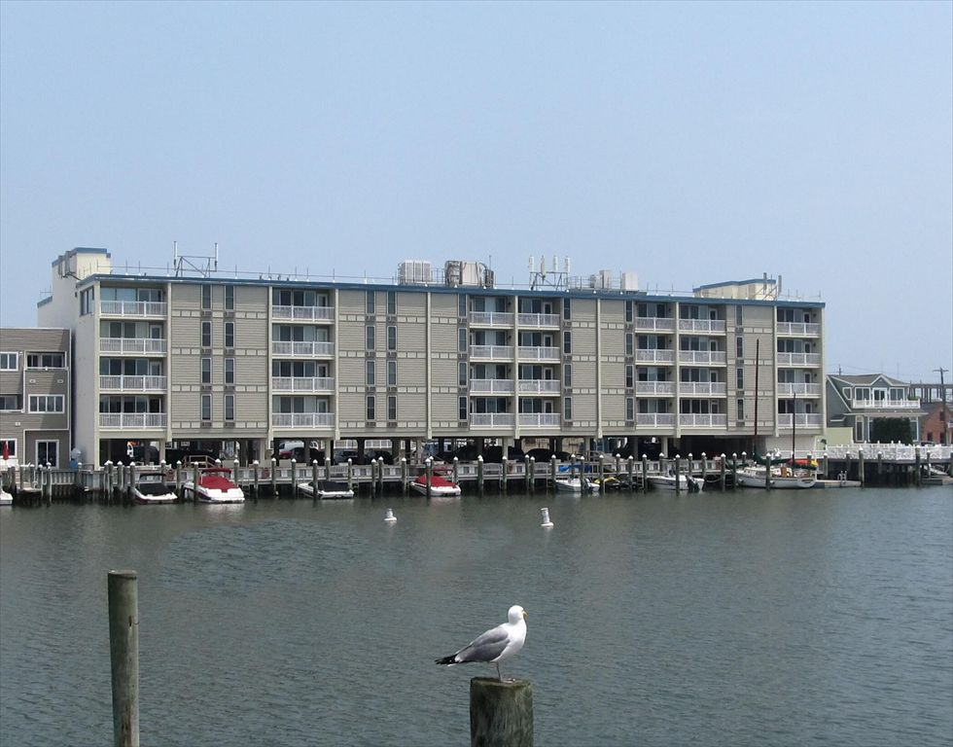
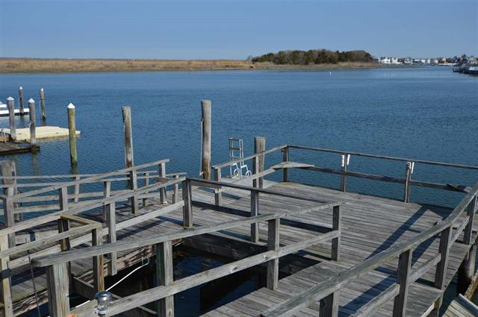
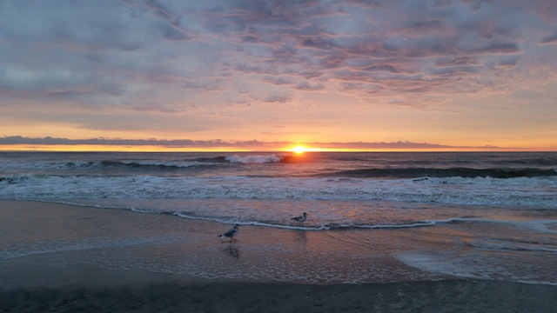
Monitoring Continues
Both the Beach and the Bay will be surveyed in the fall of this year by the Stockton Coastal Research Center.

Slide 11
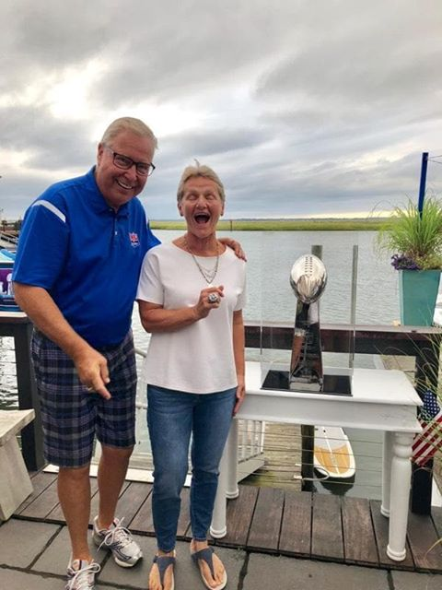
Another
Great
Summer!

Slide 12
Questions
&
Answers

