Slide 1
Since the September Meeting SHPOA has emailed
37 Beach Blasts to Members
September (1)
Off Season Property Check
August (8)
Fall Meeting
Tasting Judges
Stone Harbor Museum
Parking Survey
Stone Harbor Water Supply
President’s Message
Photo Contest Voting
Fall Meeting Agenda
July (3)
President’s Message
Save the Turtles
July News
June (5)
June News
Trustee Positions
2018 Photo Contest
Final Renewal Notice
Spring Meeting Topics
May (4)
Spring Meeting Agenda
Renewal Notice
President’s Message
National Hurricane Week
Flood Monitoring
April (4)
Dredging Update
Ocean Clean-up
Membership Renewal Solicitation-
2018 American Legion Memorial Day Parade
March, 2018 (4)
March PRESIDENTS MEMO
Construction Ordinance Update 3
Special PRESIDENTS MEMO
2017 Expired Memberships Drive
January2018 (5)
Shoreline
Vital Communications
President’s Message
Updated Construction Ordinance
SHPOA Dredging Report
December, 2017 (2)
Island Sustainability
President's Message
November, 2017 (1)
Construction Ordinance Update

Slide 2
SHPOA - Keeps You Informed
Facebook
Over 2500 “Likes”
Reaching out to over 50,000 owners, visitors, friends and renters
Updated Daily
Email Blasts
President’s Messages, Parking Survey, News and information Borough Budget Analysis, Dredging, Survey Results, Flood Planning, Water Conservation, Council Meetings to Volunteers for Beach Clean-up
Website
Members Only Access Coming Later This Year
Ability for members to update their profiles
Online Membership Renewal with new Renewal Button
Multi-year Membership

Slide 3
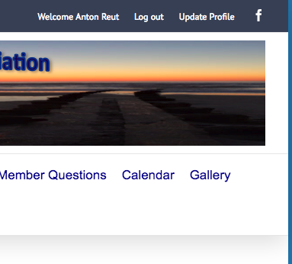
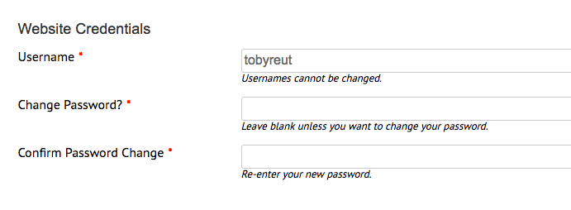
How to Update Your Password
1.
2.
3.

Slide 4
Stone Harbor Sustainability
Our Homes
Beach Nourishment
Water Usage
Flood Management
Bay Dredging & Maintenance
10 Year Financial Plan

